Slide 1
Fluvial Geomorphology: Sediment transport and Grain Size
Zach HIlgendorf

Slide 2
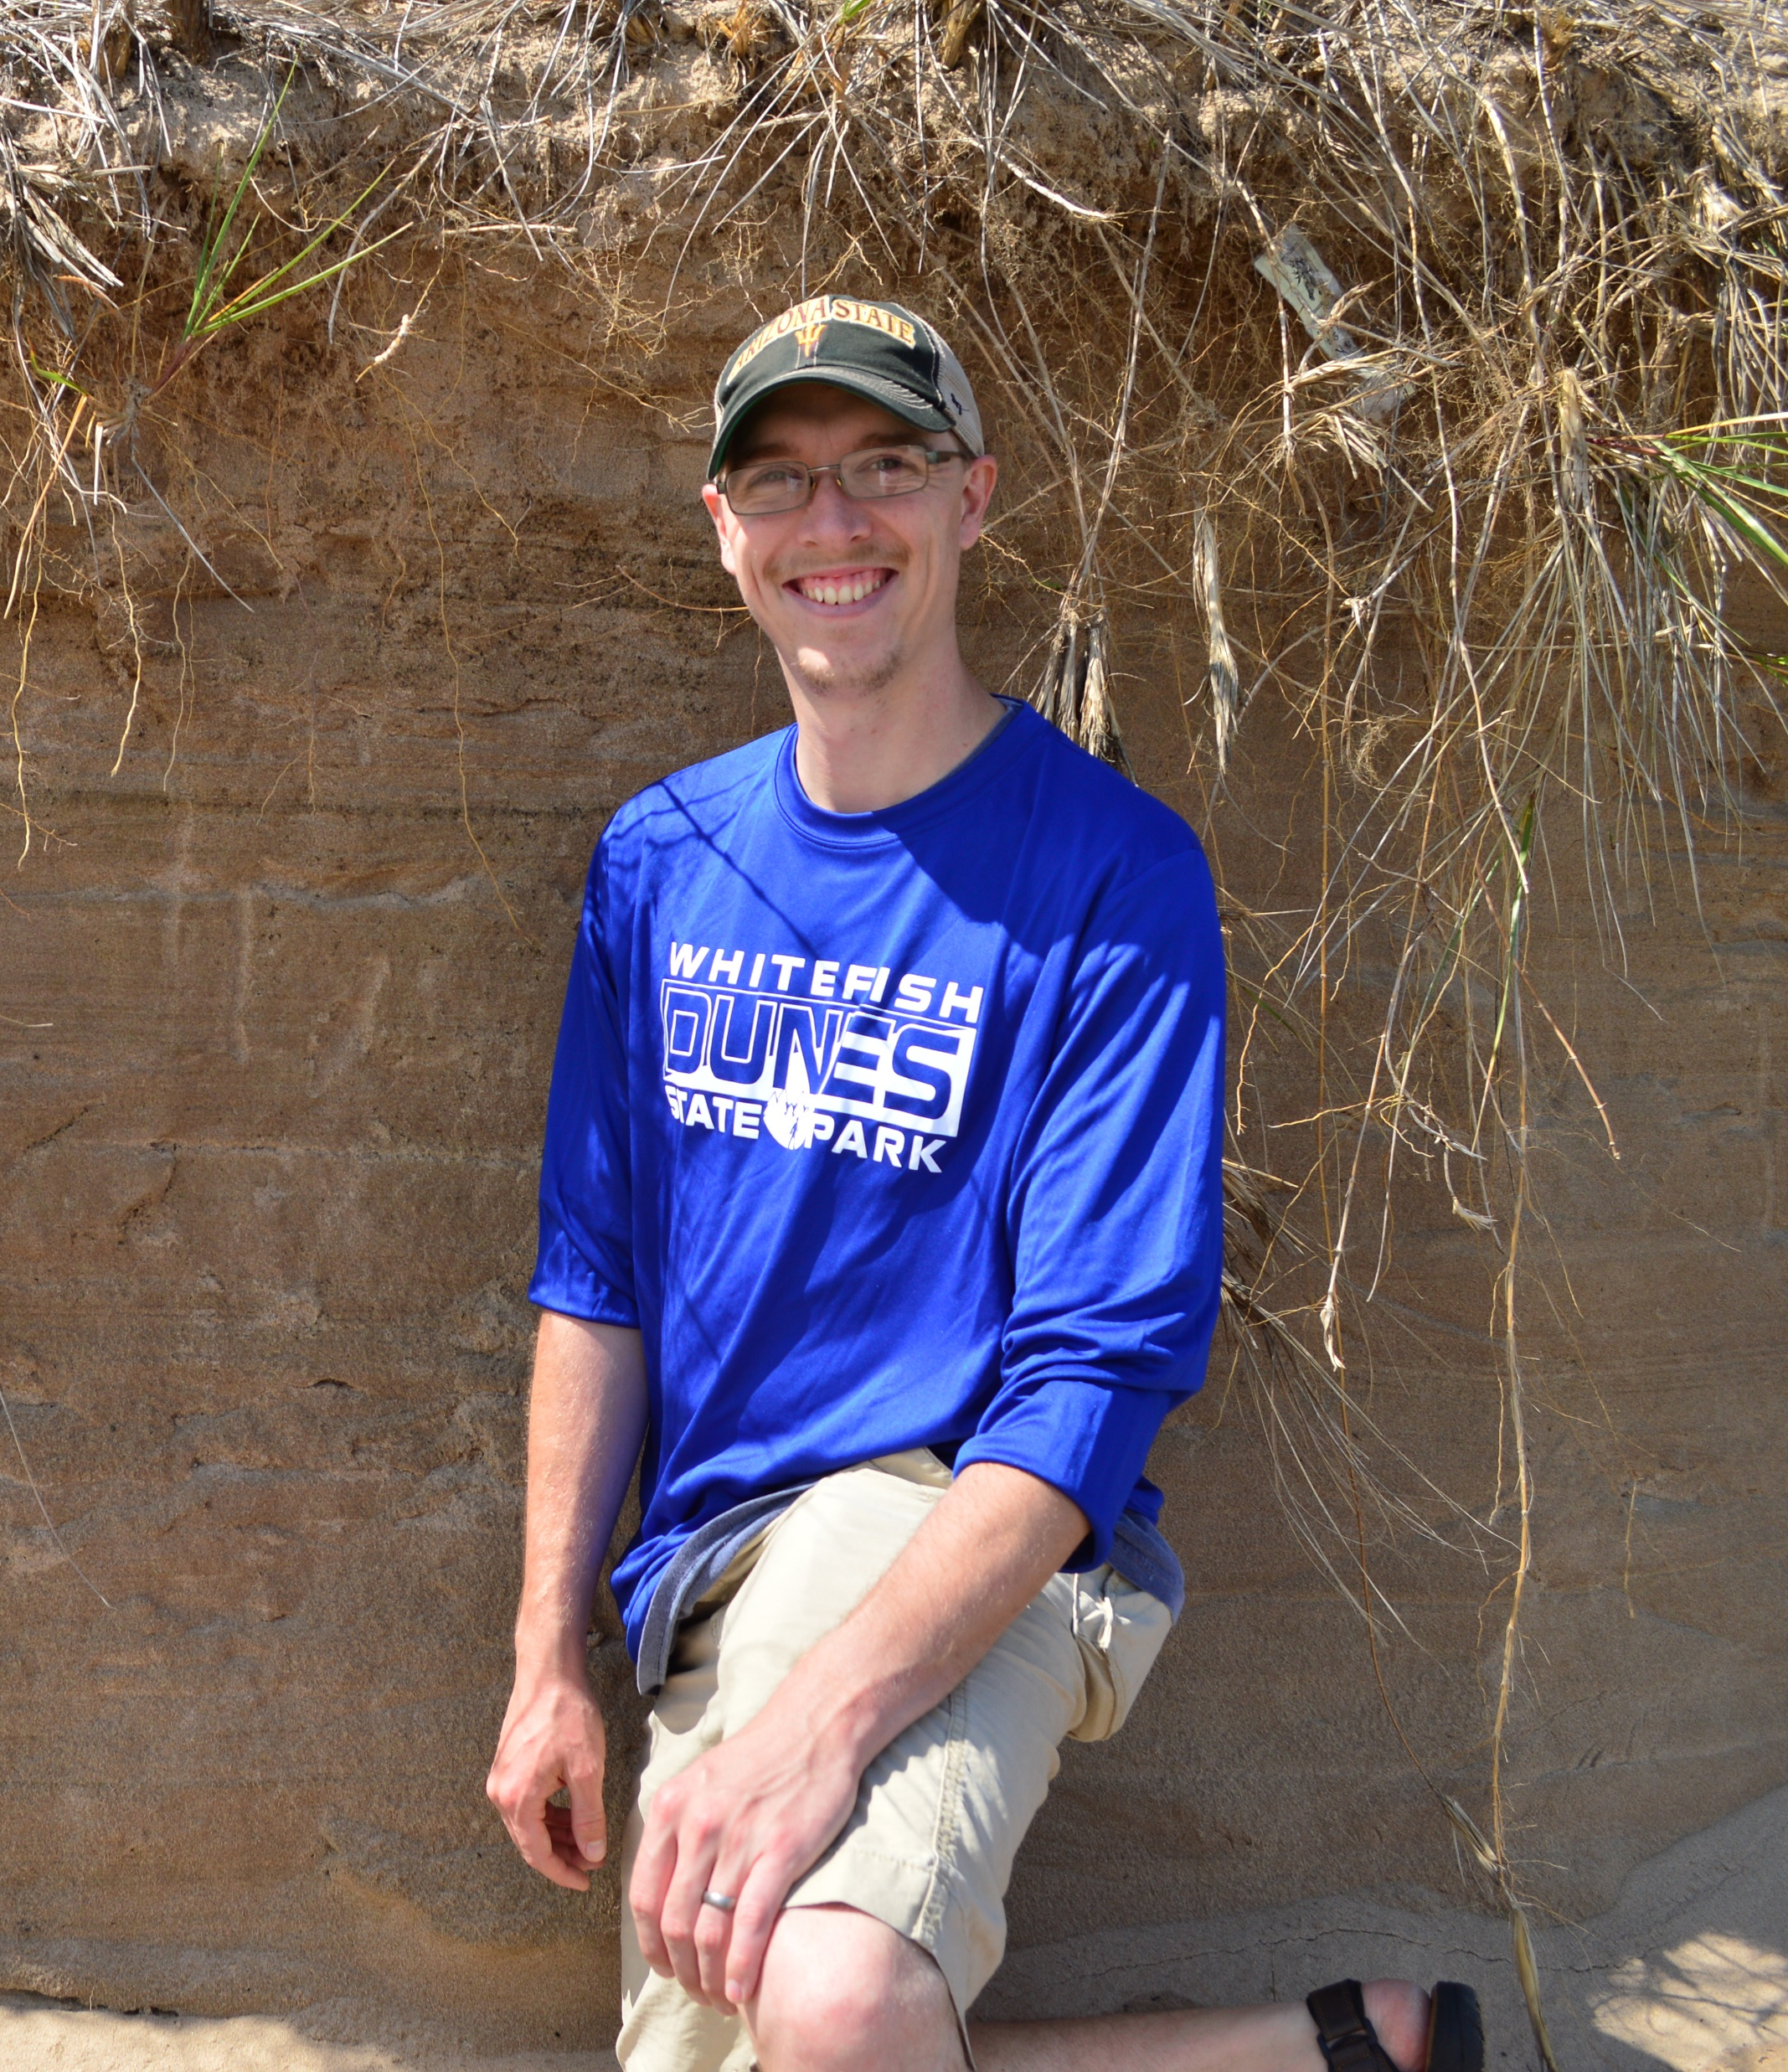
Objectives
Understand Different Grain Sizes
Understand Basic Sediment Transport Concepts
The geo-nerd currently talking…

Slide 3
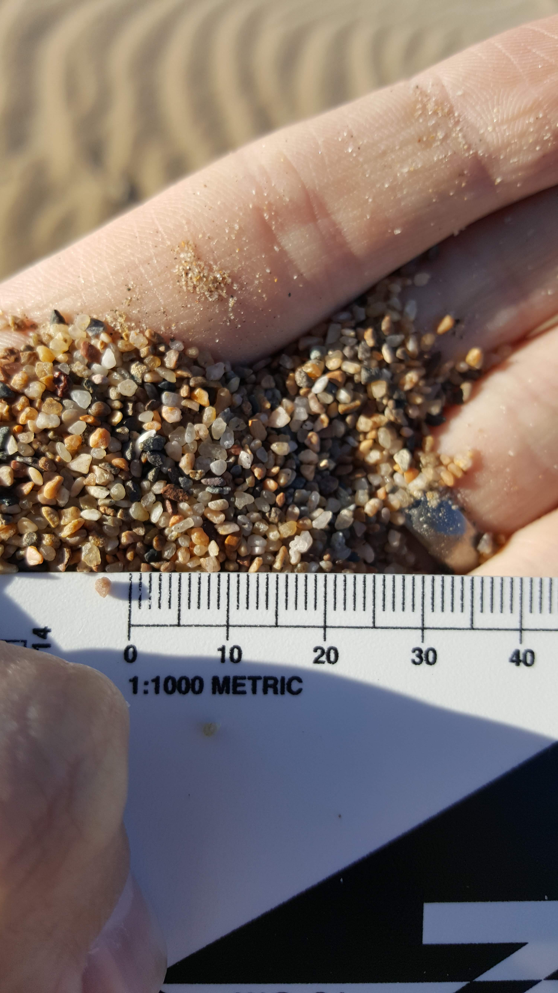
Introduction to Grains
No two grains are the same
Grains from a beach in southern California, USA

Slide 4
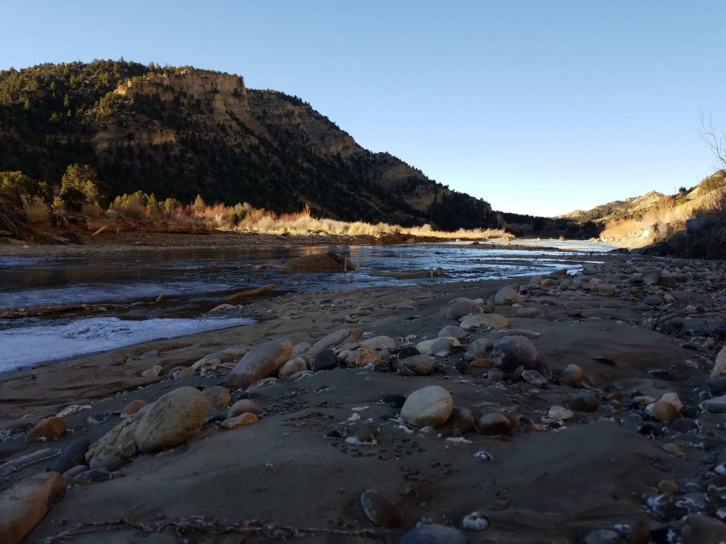
Introduction to Grains
No two grains are the same
Grains described by:
Composition
Banks of Henrieville Creek, Utah, USA.
Photo Credit: A. Hilgendorf

Slide 5
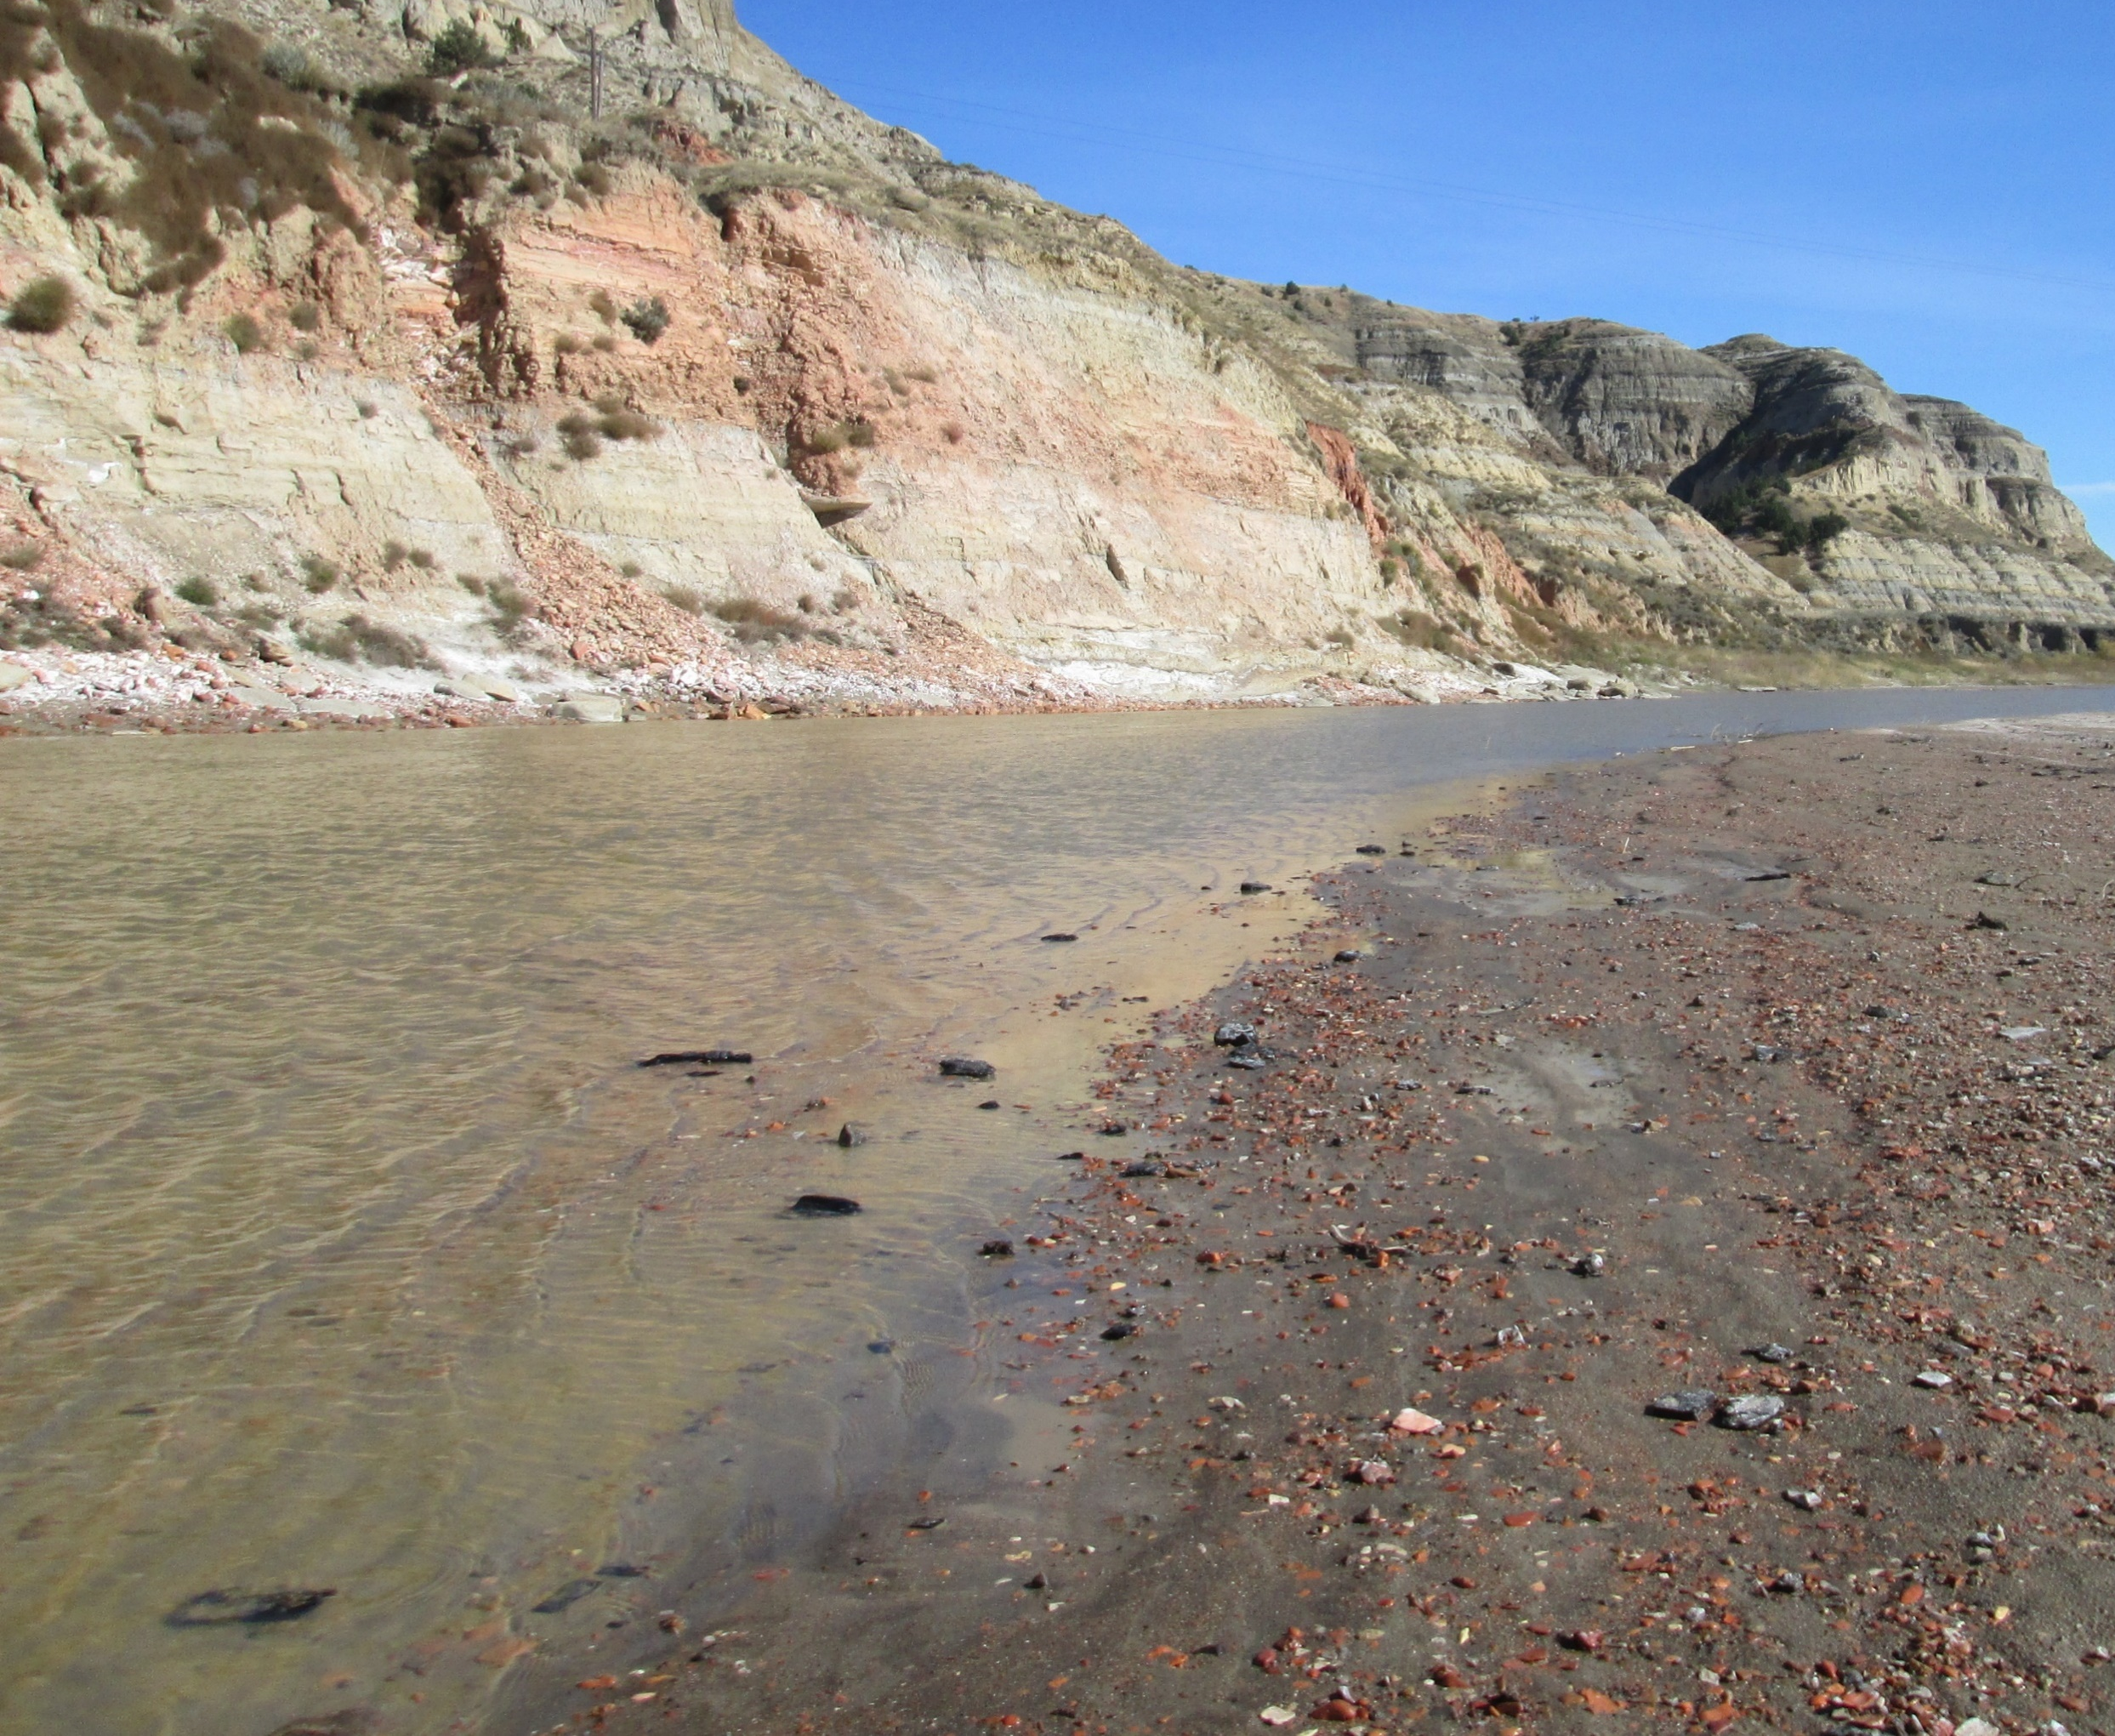
Introduction to Grains
No two grains are the same
Grains described by:
Composition
Shape
Banks of the Little Missouri River, North Dakota, USA

Slide 6
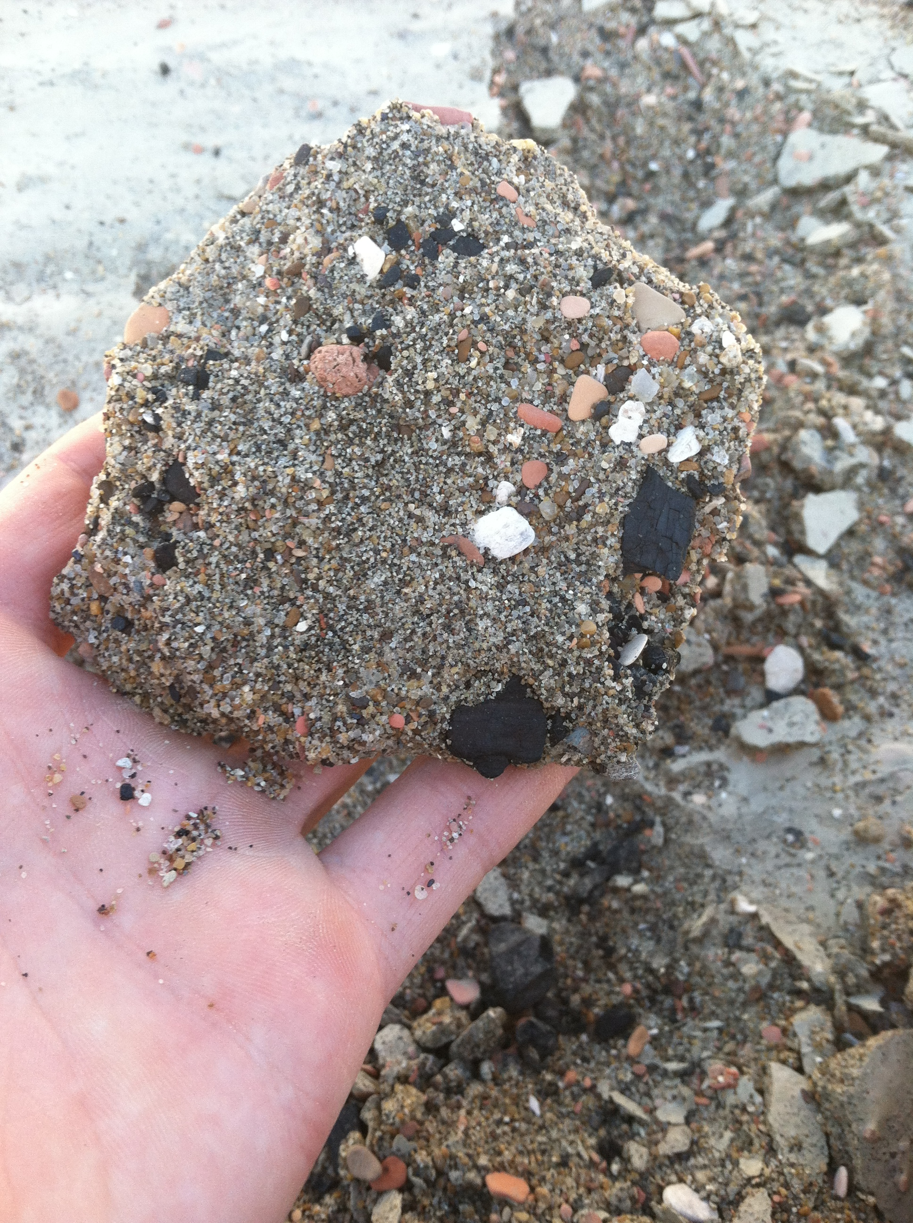
Introduction to Grains
No two grains are the same
Grains described by:
Composition
Shape
Size

Slide 7
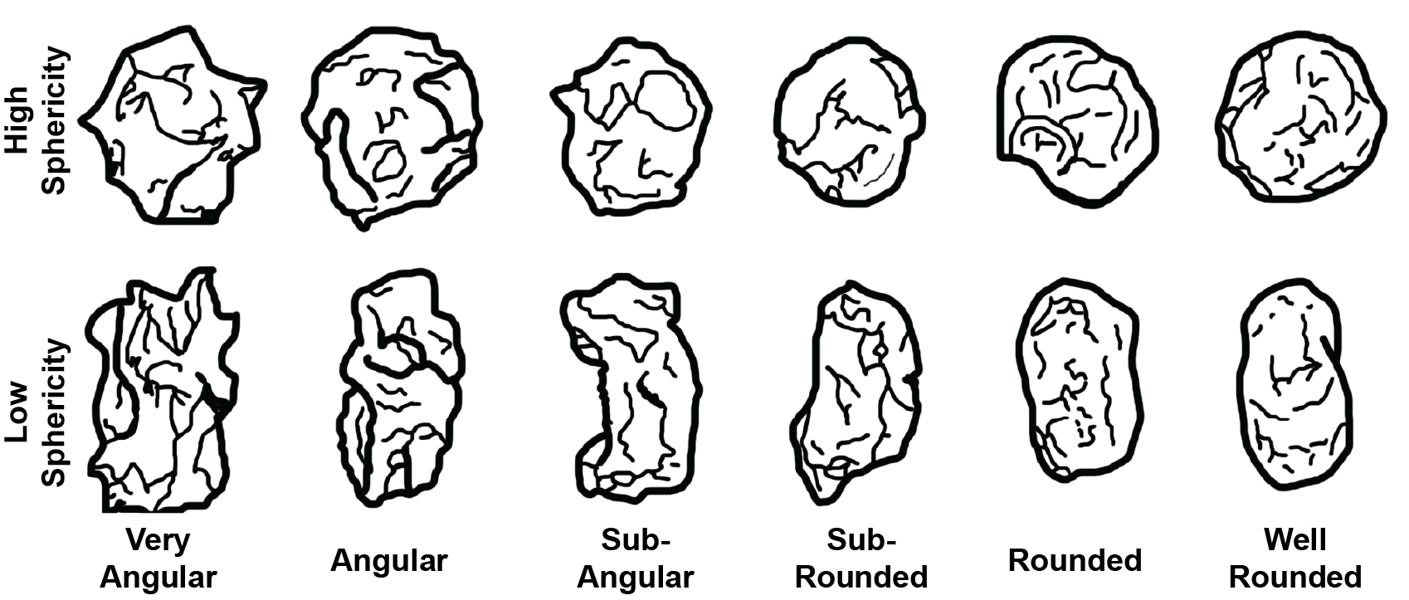
Modified and Adapted from Miller and Henderson (2010)

Slide 8
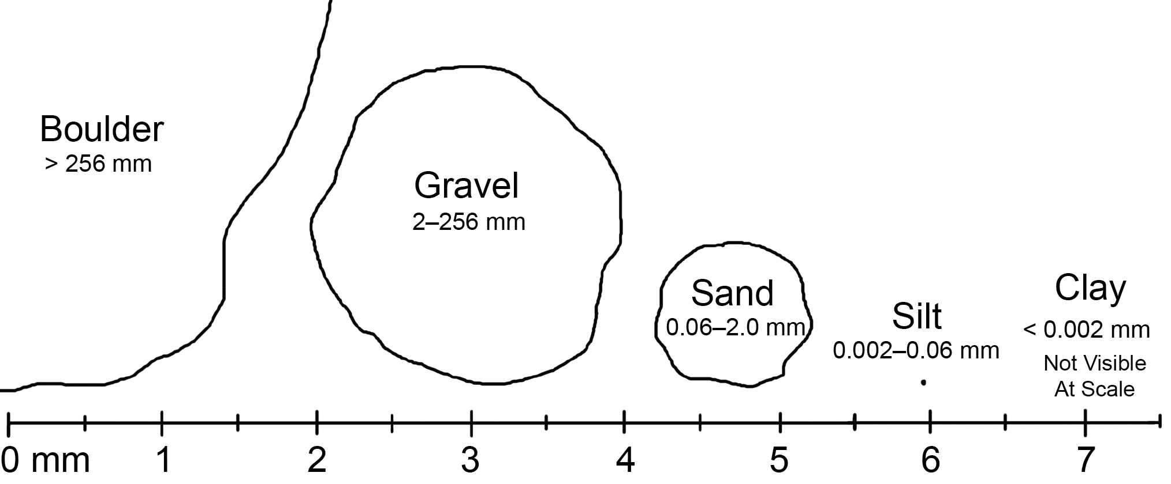

Slide 9
Initiation of Motion

Slide 10
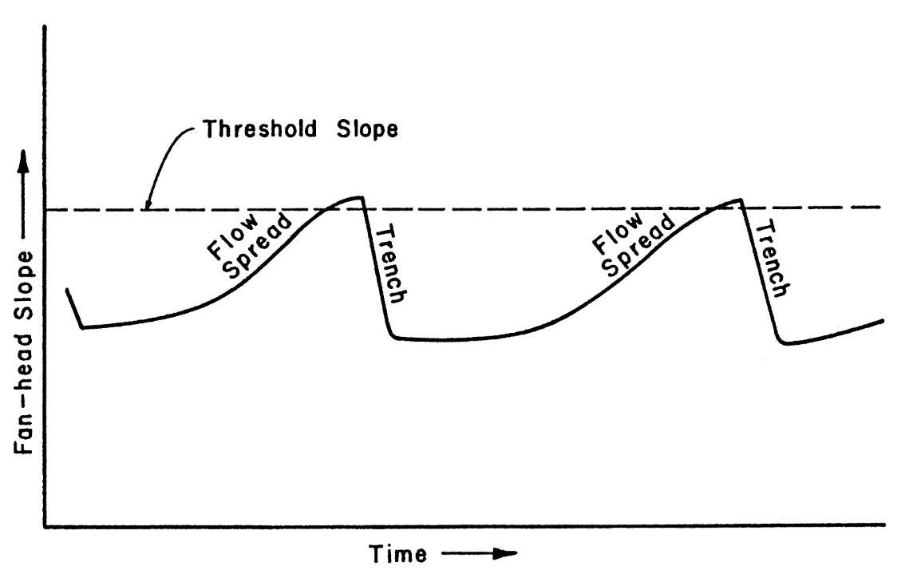
Basic Concepts
Thresholds
From Schumm (1979)

Slide 11
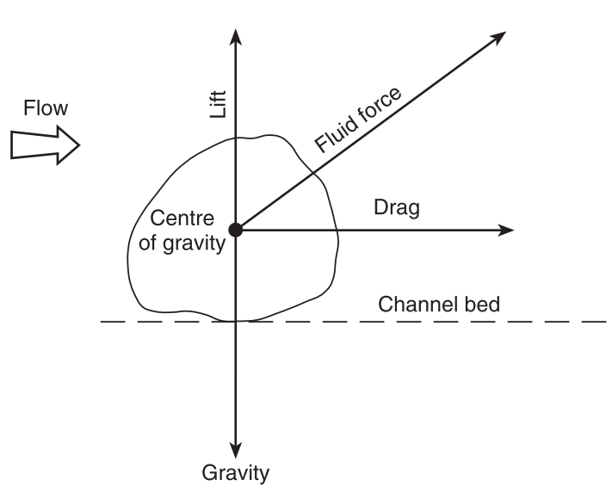
Basic Concepts
Thresholds
Initiation of Motion
F = ma
From Charlton (2008), Adapted from Morisawa (1985)

Slide 12
Basic Concepts
Thresholds
Initiation of Motion
F = ma
F_{g}
From Charlton (2008), Adapted from Morisawa (1985)

Slide 13
Basic Concepts
F_{L}
Thresholds
Initiation of Motion
F = ma
F_{g}
From Charlton (2008), Adapted from Morisawa (1985)

Slide 14
Basic Concepts
F_{L}
Thresholds
Initiation of Motion
F_{D}
F = ma
F_{g}
If F_{g} ≥ F_{L} + F_{D}
Grain stays at rest!
From Charlton (2008), Adapted from Morisawa (1985)

Slide 15
Basic Concepts
F_{L}
Thresholds
Initiation of Motion
F_{D}
F = ma
F_{g}
If F_{g} < F_{L} + F_{D}
Transport occurs!
From Charlton (2008), Adapted from Morisawa (1985)

Slide 16
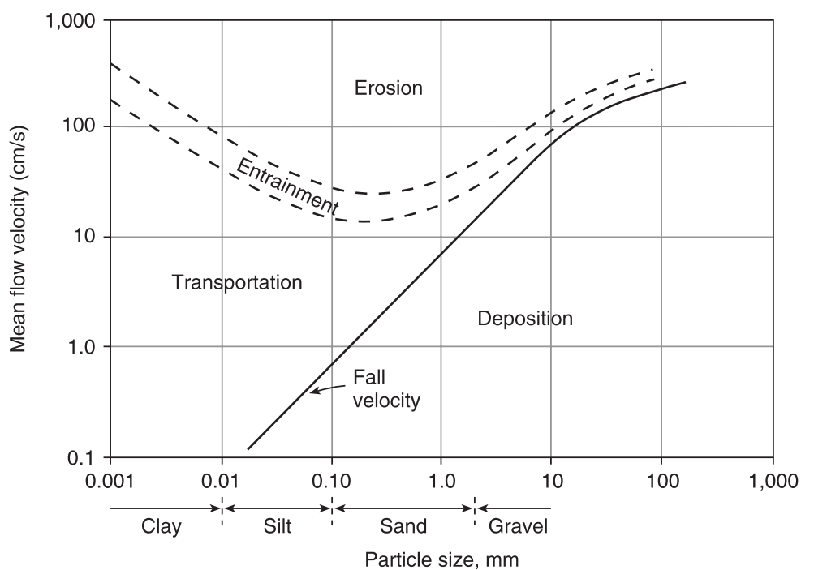
Basic Concepts
Thresholds
Initiation of Motion
Hjulström Curve (1935)
From Charlton (2008), Adapted from Hjulström (1935)

Slide 17
Basic Concepts
Thresholds
Initiation of Motion
Hjulström Curve (1935)
From Charlton (2008), Adapted from Hjulström (1935)

Slide 18
Basic Concepts
Thresholds
Initiation of Motion
Hjulström Curve (1935)
From Charlton (2008), Adapted from Hjulström (1935)

Slide 19
Basic Concepts
Thresholds
Initiation of Motion
Hjulström Curve (1935)
Transport!
From Charlton (2008), Adapted from Hjulström (1935)

Slide 20
Basic Concepts
Thresholds
Initiation of Motion
Hjulström Curve (1935)
No
Transport!
From Charlton (2008), Adapted from Hjulström (1935)

Slide 21
Basic Concepts
Thresholds
Initiation of Motion
Hjulström Curve (1935)
Transport!
From Charlton (2008), Adapted from Hjulström (1935)

Slide 22
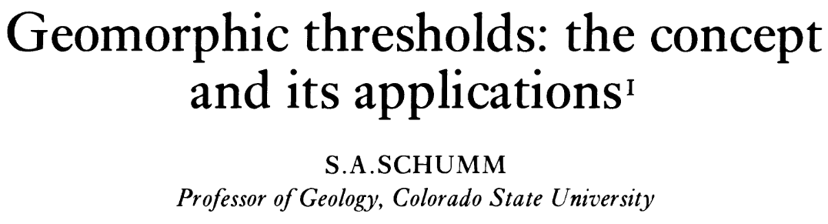

Recap
Grain Shape
Grain Size
Geomorphic Thresholds
Initiation of Motion
Hjulström Curve

Slide 23
Recap
Grain Shape
Grain Size
Geomorphic Thresholds
Initiation of Motion
Hjulström Curve

